Slide 1
NON SYLLABUS PROJECT
POORNIMA GROUP OF INSTITUTIONS

Slide 2
Submitted by:-
Registration No:-PGI20CA028
Name:- Prabhupad Vyas
Section:- G
College:- PGI
Topic:- E-Learning
Registration No:-PGI20CA027
Name:-Nipun Tiwari
Section:-G
College:-PGI
Topic:- E-Learning

Slide 3
Abstract:-
E-learning fulfils the thirst of knowledge and offers online content that can be delivered for the learner at anywhere, anytime and any age through a wide range of e-learning solution while compared with traditional learning system. It also provides the rapid access to specific knowledge and information.

Slide 4
What is E-Learning ?
A learning system based on formalised teaching but with the help of electronic resources is known as E-learning. While teaching can be based in or out of the classrooms, the use of computers and the Internet forms the major component of E-learning.

Slide 5
E-Learning:- BANE or BOON ?
BANE
Saves time and money.
Better retention.
Personalized learning.
Environment-friendly.
BOON
Lacks social interaction.
Cheating is unavoidable.
Focuses more on theory.
Inaccessible to others.

Slide 6
Conclusion:-
E-learning is not just a change of technology. It is part of a redefinition of how we as a species transmit knowledge, skills, and values to younger generations of workers and students.

Slide 7
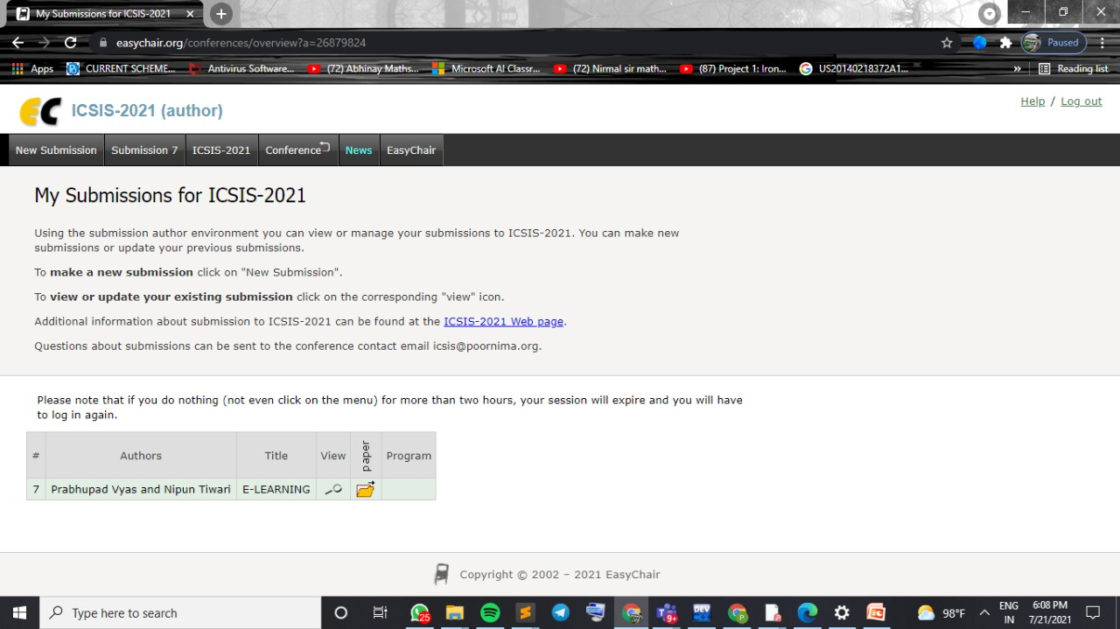

Slide 8
